Slide 1
secure data hiding in image using steganography
CAPSTONE PROJECT
Presented By: Balagoni Sowmya
Student Name : Balagoni Sowmya
College Name & Department : Sphoorthy engineering college & cyber security

Slide 2
OUTLINE
Problem Statement
Technology used
Wow factor
End users
Result
Conclusion
Git-hub Link
Future scope

Slide 3
Problem Statement
In the digital age, data security is of utmost importance, especially when sensitive information needs to be transmitted over insecure networks. One of the effective methods to achieve secure transmission is through steganography, the practice of hiding information within other seemingly harmless data, such as an image. The challenge lies in embedding data in such a way that the hidden information remains undetectable by unauthorized users while ensuring the integrity and accessibility of the original data.

Slide 4
Technology used
Libraries:
1.CV2:CV2 is a powerful library for working with images in Python.
2. Windows OS:Microsoft Windows, computer operating system (OS) developed by Microsoft Corporation to run personal computers (PCs).
3.String:The Python string module provides several constants that are useful for checking to see if a character, slice, or string contains letters, digits, symbols, etc.
PLATFORMS:
1.IDLE:IDLE stands for Integrated Development and Learning Environment. It is a Python IDE that helps programmers write Python code.
.

Slide 5
Wow factors
The project secure data hiding in images using steganography was created to address several critical needs in the fields of information security, privacy, and covert communication. Below are the key reasons why this technology was developed:
1. Enhancing Data Privacy and Security
2. Protection Against Cyber Threats
3. Covert Communication

Slide 6
End users
Government and Military:
Use Case: Transmitting classified or sensitive information (e.g., troop movements, mission details) without detection by adversaries.
End Users: Intelligence agencies, defense organizations, and military personnel.
Healthcare Organizations:
Use Case: Securely embedding patient data (e.g., medical records, diagnostic information) within medical images (e.g., X-rays, MRIs) for sharing between hospitals or specialists.
End Users: Hospitals, clinics, radiologists, and healthcare IT professionals.
Cybersecurity Professionals:
Use Case: Testing and developing secure communication channels or training tools for steganography detection.
End Users: Cybersecurity firms, ethical hackers, and IT security teams.

Slide 7
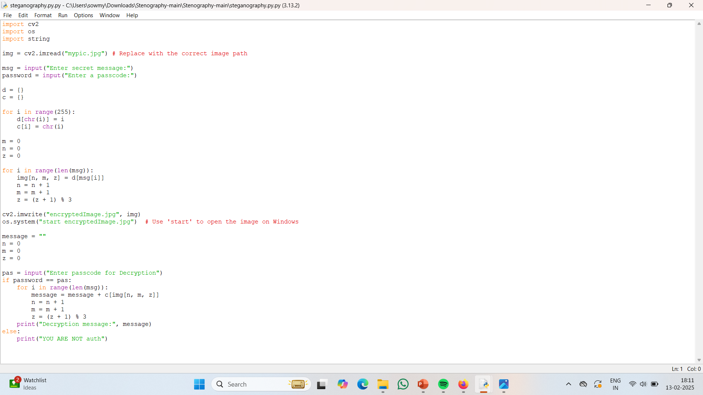
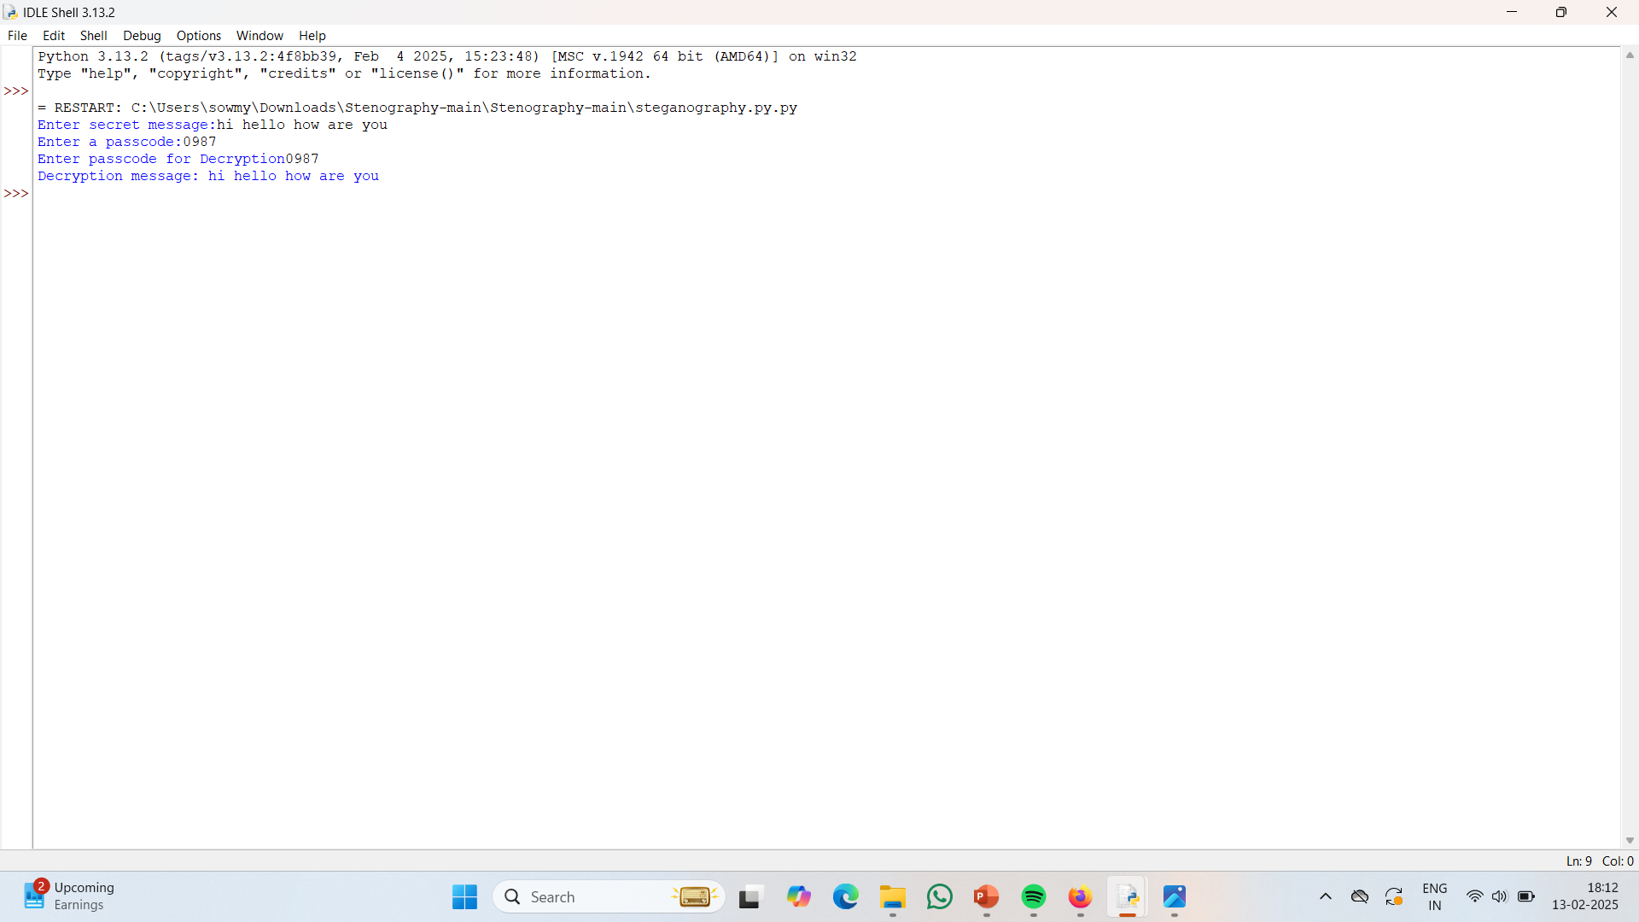
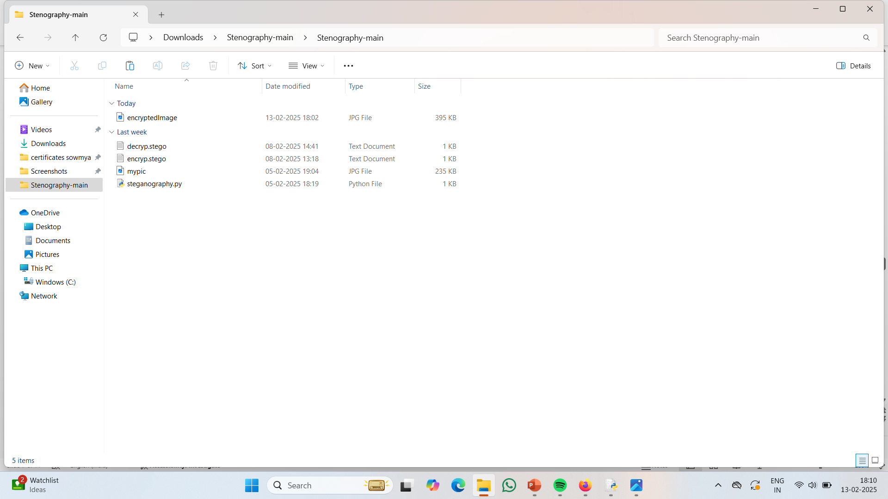
Results

Slide 8
Conclusion
In conclusion, steganography provides an effective solution for securing sensitive information in the digital age, especially when transmitted over insecure networks. By embedding data within seemingly innocuous files like images, it offers a means of protecting privacy without raising suspicion. However, the key challenge lies in striking a delicate balance between concealing the hidden information from unauthorized users and preserving the integrity and accessibility of the original data. Continued advancements in steganographic techniques, as well as the development of sophisticated detection methods, will play a critical role in ensuring both the effectiveness and security of this approach in safeguarding sensitive communications.

Slide 9
GitHub Link
https://github.com/Sowmyabalagoni/AICTE-Project.git

Slide 10
THANK YOU

